Slide 1
Hydrothermally synthesized Nanoflower-like structured NiO electrode for Supercapacitor Applications
Ponnam Rahul
21PHE0011
Supervisor: Prof. K. Thangaraju
1

Slide 2
Outline
Introduction
Classification
Electric Double Layer Capacitor
Pseudo Capacitor
Literature Survey
Synthesis of Nickel Oxide
Results and discussion
2

Slide 3
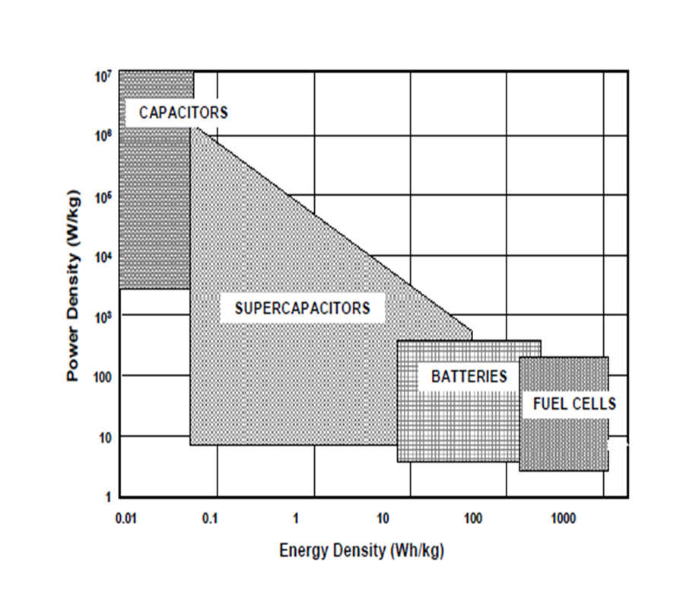
Ragone Plot
Supercapacitors fill the gap between batteries and traditional devices. In terms of specific energy and specific power.
Batteries and low temperature fuel cells are typical low power devices whereas conventional capacitors may have a power density of >10⁶ watts per dm³ at very low energy density.
The supercapacitor should have a longer cycle life than batteries because there is little or no chemical change.
3

Slide 4



Supercapacitors
Supercapacitors
Electric Double Layer capacitors
Hybrid capacitors
Pseudo capacitors
Activated carbons
Composite Hybrid
Conductive Polymers
Battery type Hybrid
Carbon nanotubes
Asymmetric Hybrid
Metal Oxides
Graphene
4

Slide 5
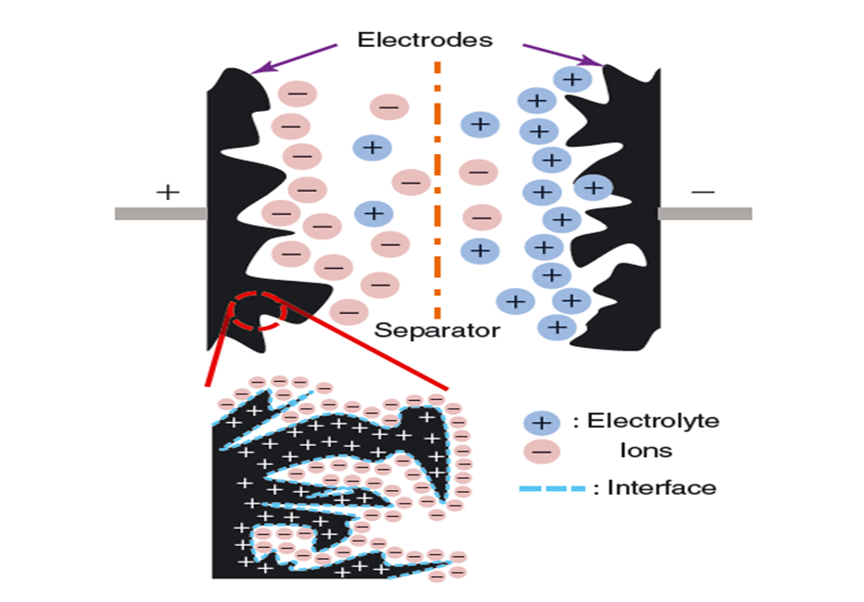

Electric Double Layer Capacitor
The storage mechanism in EDLC is electrostatic.
EDLCs utilize the interfaces between the electrode and the electrolyte for their energy storage.
The thickness of the double layer is much smaller than that of the separator.
C = $\frac{A∗ε}{d}$
Energy Density = $\frac{Cs\left(ΔV\right)2}{2}$
Power density = energy density / time discharge
5

Slide 6
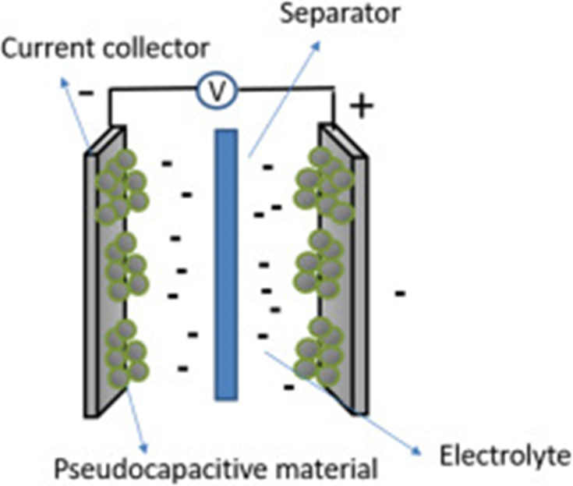
Pseudocapacitor
The storage mechanism in Pseudo capacitor is electrochemical in nature.
Faradaic processes allow pseudo capacitors to achieve greater (10 -100 times) capacitances and energy densities than EDLCs.
Pseudo capacitors store charge faradaically through the transfer of charge between electrode and electrolyte.
This is accomplished through electro sorption, reduction-oxidation reactions, and intercalation processes
6

Slide 7
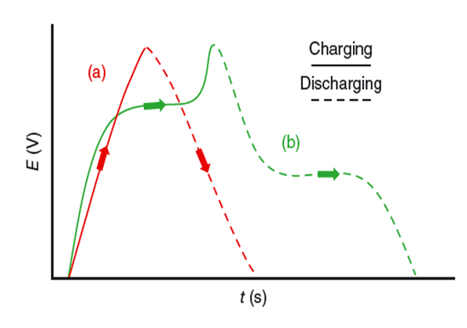
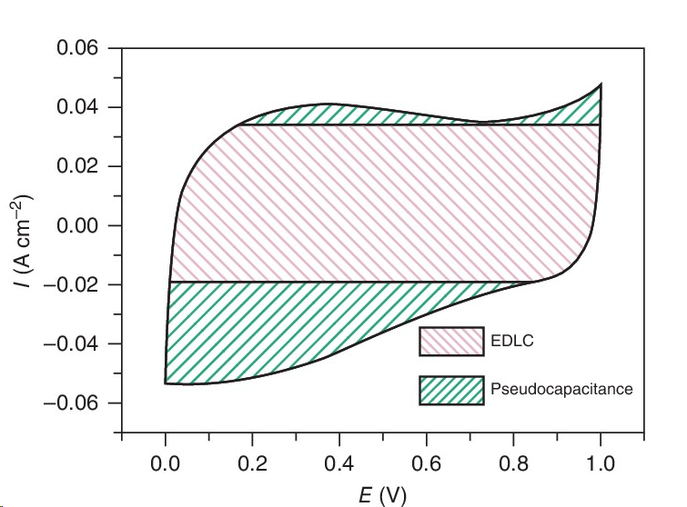
EDLC and Pseudo Capacitor
Galvanostatic charge discharge
Cyclic Voltammetry Curve
Electrochemical Double Layer Capacitor.
Pseudo Capacitor.
7

Slide 8
Literature Survey
Parameters | EDLC | Pseudo Capacitors | Hybrid Capacitors | References
Storage Mechanism | Electrostatically | Electrochemically | Electrostatically and Electrochemically | R.S. Kate et al./ Journal of alloys and compounds 734 (2018) 89e11
Specific Capacitance | Low | High | High | International journal of Hydrogen energy 34 (2009) 4889-4889
Energy Density | Low | High | High | International journal of Hydrogen energy 34 (2009) 4889-4889
Power Density | High | Low | High | International journal of Hydrogen energy 34 (2009) 4889-4889
Electrode Material | Carbon based Materials | Metal Oxides(NiO, Mno₂,Co₃O₄ etc.) | Carbon based material + Metal Oxides / Conductive Polymers | Electrochemical Energy Reviews (2020) 3:155-186
8

Slide 9
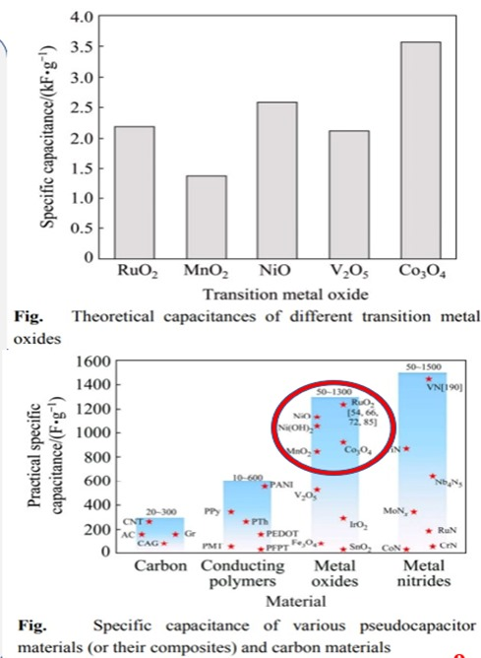
Nickel(II) Oxide (NiO)
Transition metal oxides theoretical specific capacitances are 2200, 1370, 2584, 2120, 3560 F/g of RuO₂, MnO₂, NiO₂, V₂O₅, Co₃O₄ respectively.
NiO exhibits high theoretical and practical values.
Surface properties, less toxicity.
Thermal and Chemical stability.
Various oxidation state for efficient charge transfer.
Excellent electrochemical properties.
Different nanostructured morphologies.
9

Slide 10
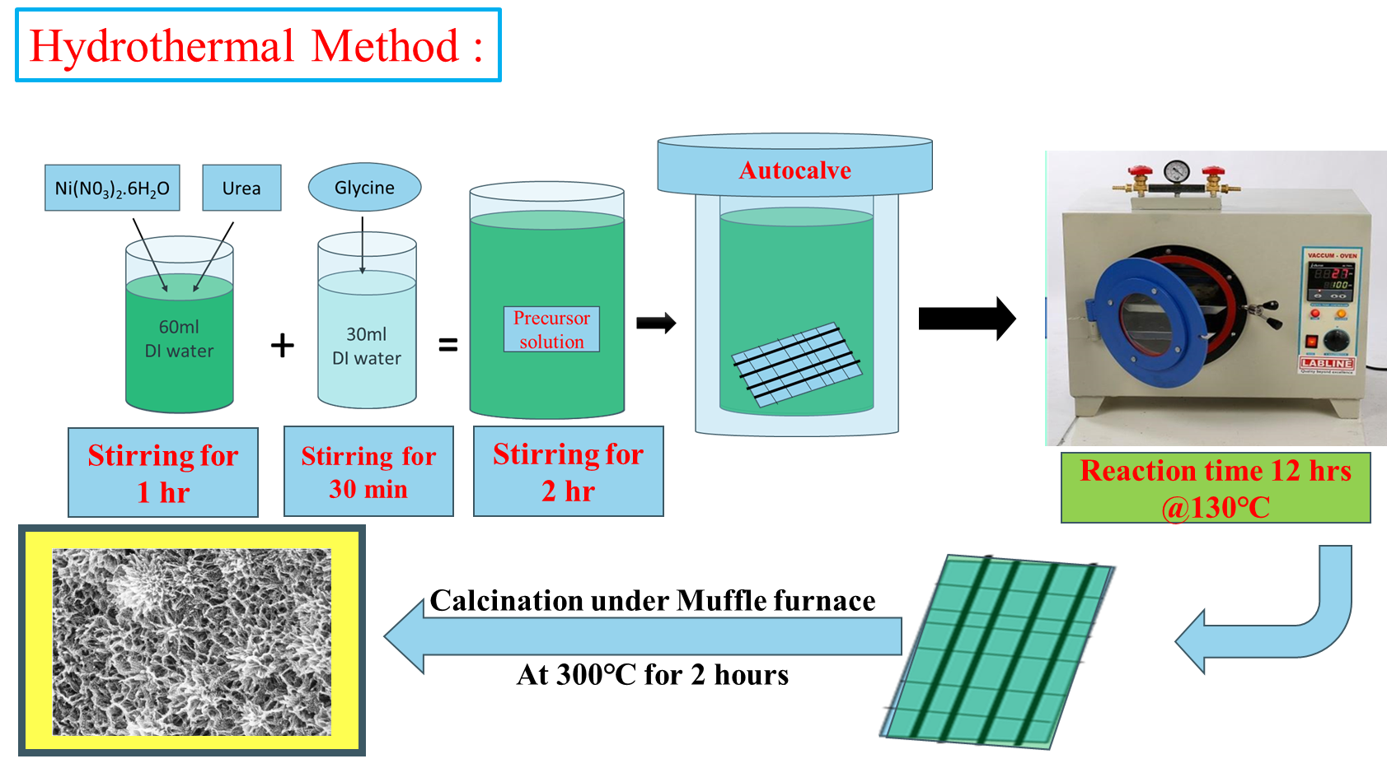
Synthesis of Nickel Oxide
10

Slide 11
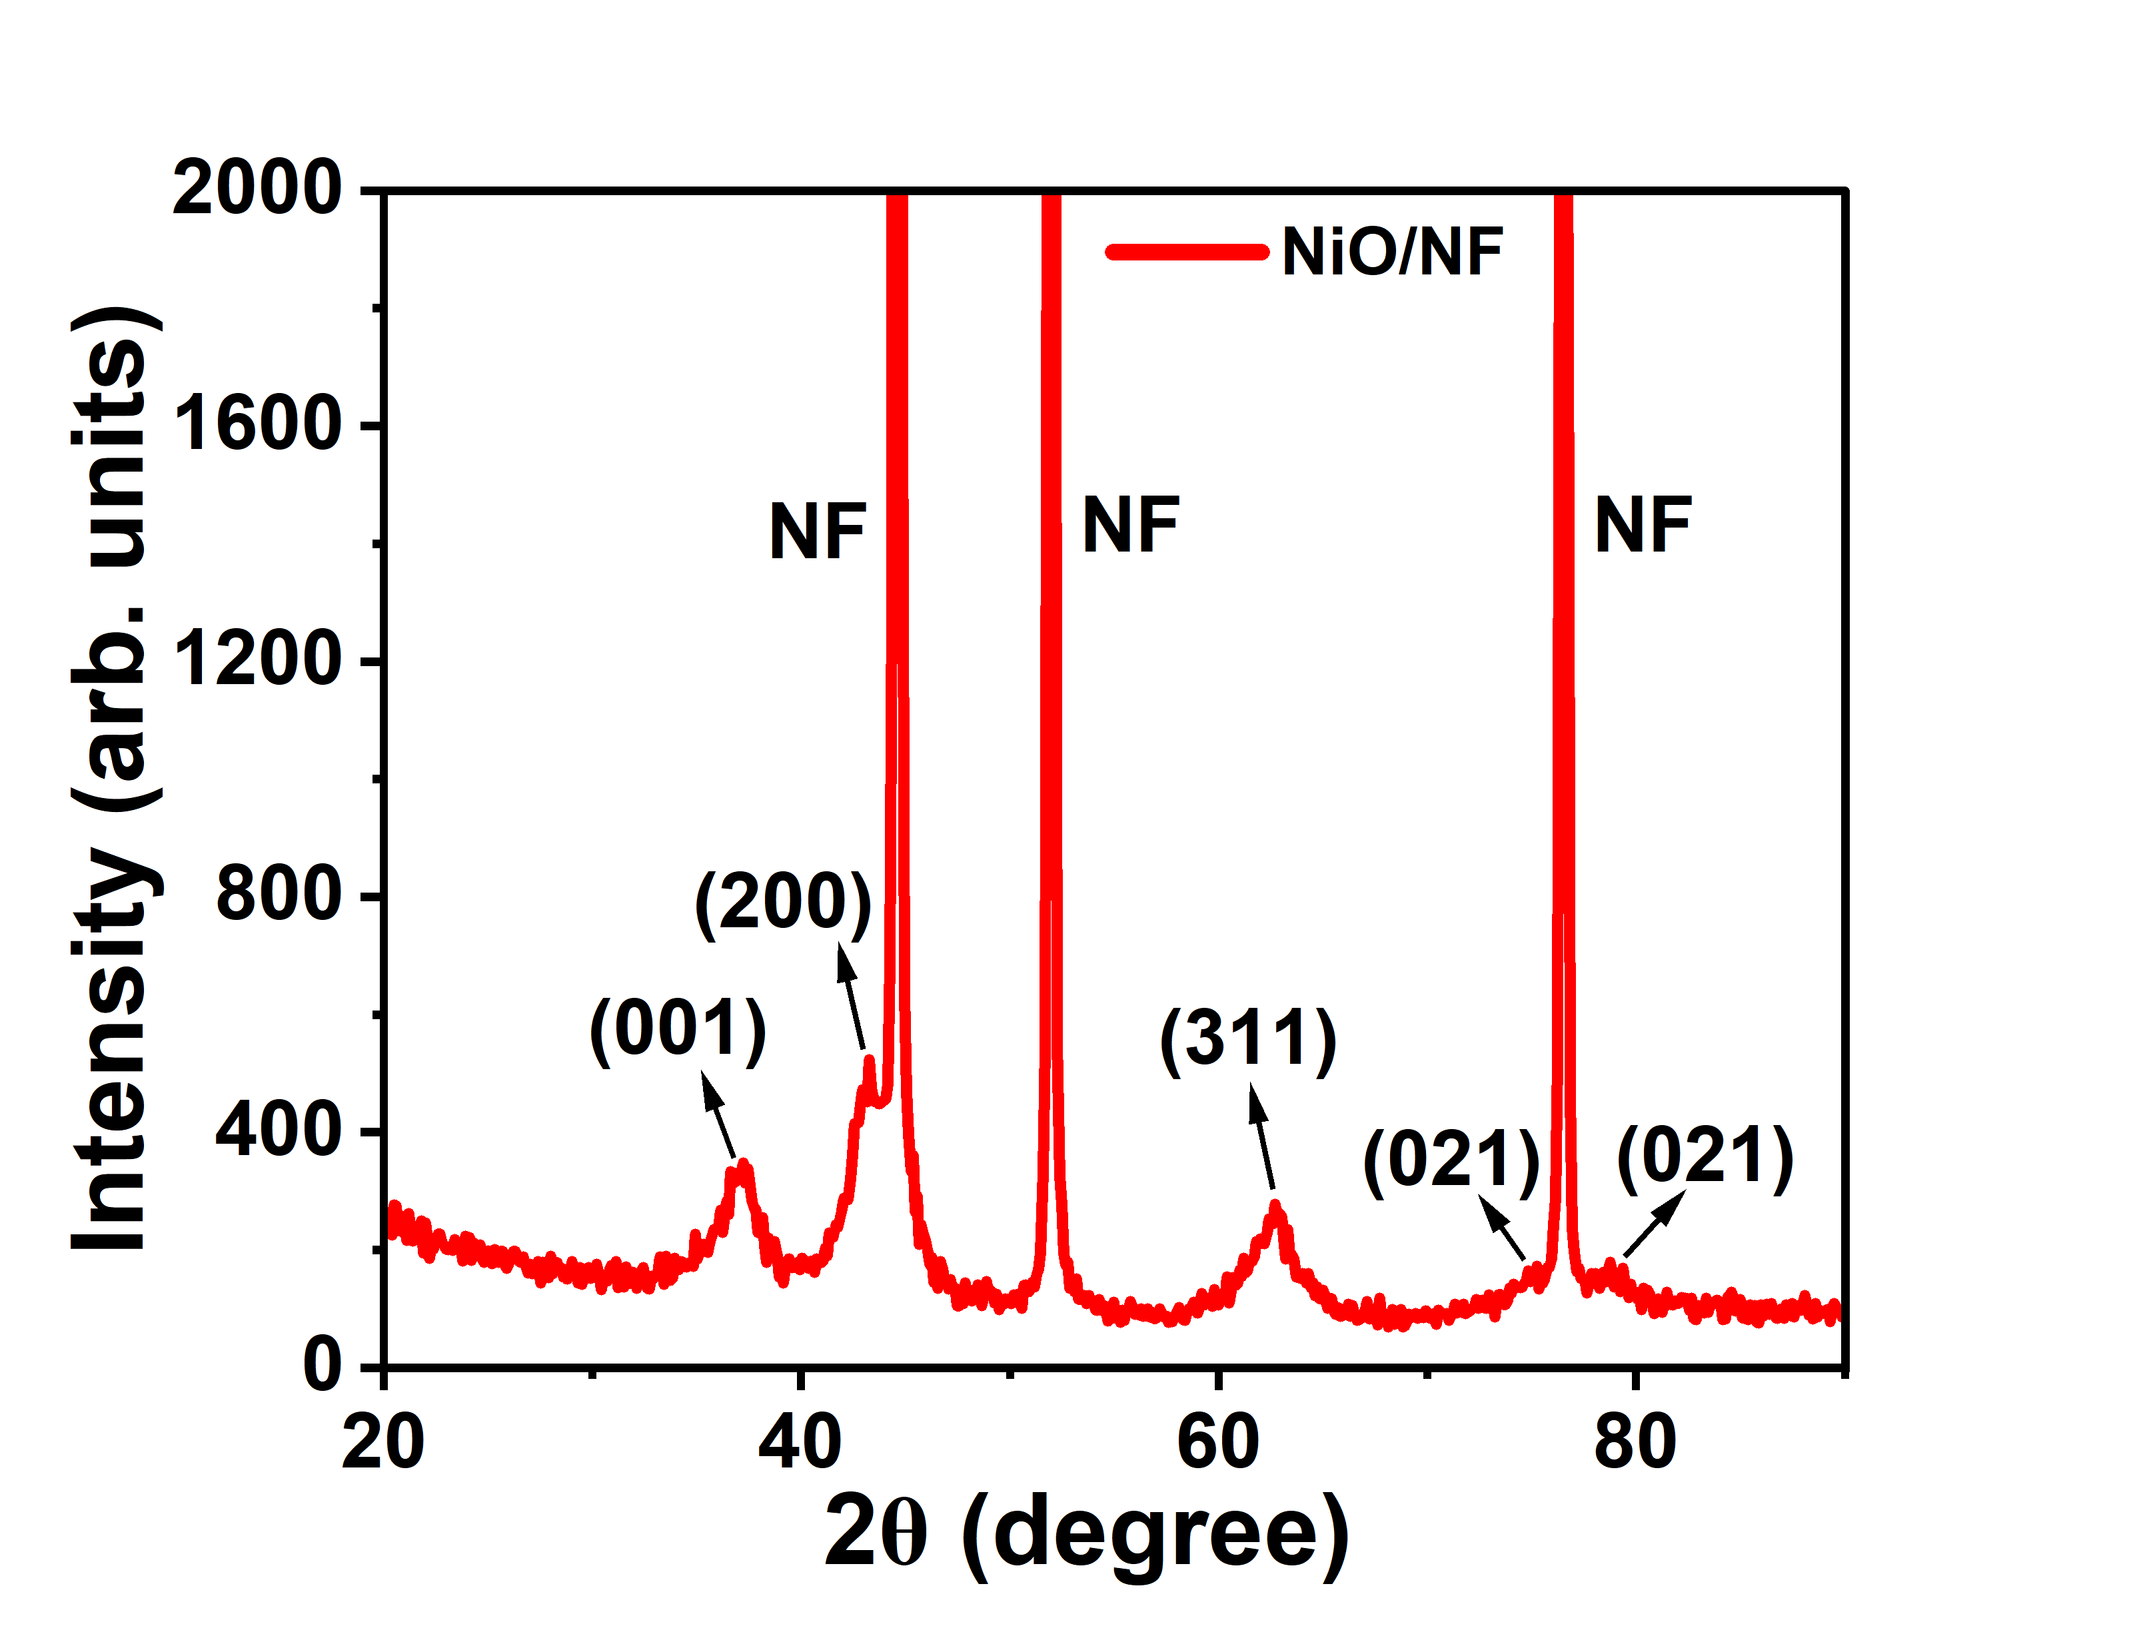
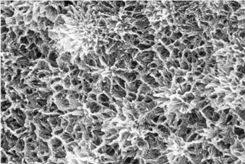
Results and discussion
XRD
FESEM
From the XRD results , 2θ values 37.11◦, 43.22◦, 62.63◦, 75.63◦ and 79.50◦ correspond to (001), (200), (111), (021) and (002) lattice planes respectively and matched with JCPDS of NiO (03-065- 6920).
From the FESEM results, synthesised NiO exhibit flower like structure. This flower like structure act as ion diffusions paths during electrochemical reactions.
11

Slide 12
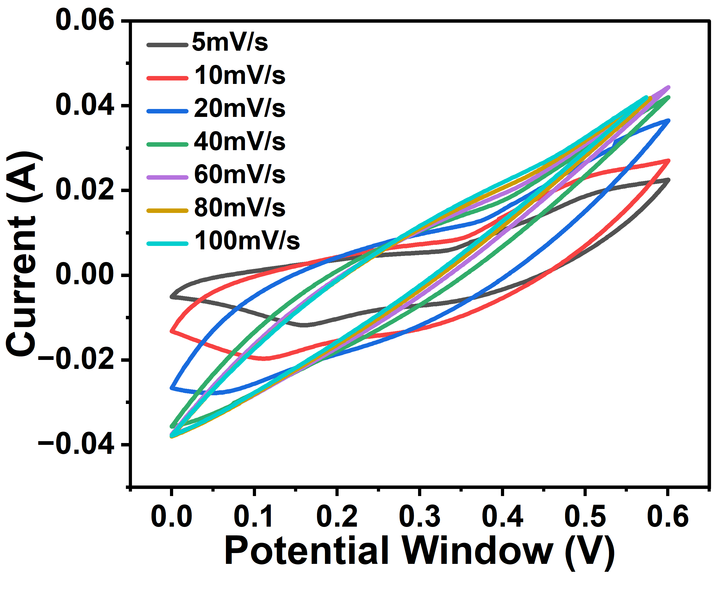

Electrochemical Studies:
CV curves shows that the non rectangular shape, this is due to the Pseudo capacitive behaviour of the NiO electrode.
When we are increasing scan rate from 5 mV/s to 100 mV/s area under the curve is increasing this is the capacitive nature of the electrode.
C_{S}-Specific capacitance, A-area under the cv-curve, m-mass loading of the electrode, ΔV- Potential Window, ϑ-scan rate.
Specific capacitance of synthesised NiO electrode is 1111 Fg⁻¹ at 5mV/s.
(Cyclic Voltammetry (CV) curves)
12

Slide 13
References
R.S. Kate et al., Journal of alloys and compounds 734 (2018) 89e11.
International journal of Hydrogen energy 34 (2009) 4889-4889.
Electrochemical Energy Reviews (2020) 3:155-186.
S.D. Dhas et al ,Vacuum 181 (2020) 109646.
Supercapacitors: A Brief Overview, Marin S. Halper, James C. Ellenbogen, March 2006, MP 05W0000272.
Electrochemical Supercapacitors for Energy Storage and Conversion Brian Kihun Kim1, Serubbable Sy1, Aiping Yu1, and Jinjun Zhang2.
Hybrid energy storage devices: Li-ion and Na-ion capacitors.
Perovskites for Supercapacitors Ehsan Rezaie1, Abdollah Hajalilou1, and Yuanhai Su2.
Synthesis of NiO nanoparticles for supercapacitor application as an efficient electrode material.
13

Slide 14
Thank you
14

